Slide 1


Slide 2






Slide 4

WORK-CASE №1
Git & GitHub
Презентацію підготувала студентка групи РПЗ-13а
Балджі Валерія

Slide 5


What is Git?
Git is a version control system that allows you to keep track of changes in your code by saving "snapshots" at different stages of development. It helps developers to collaborate by avoiding conflicts and preserving the history of changes.

Slide 6

Basic Git commands
git init - initializes a new Git repository in the current folder.
git add <file> - adds changes to a specific file to the index.
git commit -m "comment" - commits changes to a repository with a comment.
git push - sends changes to a remote repository.

Slide 7

About commits
Similar to saving a file that's been edited, a commit records changes to one or more files in your branch. Git assigns each commit a unique ID, called a SHA or hash, that identifies:
the specific changes;
when the changes were made;
who created the changes.

Slide 8

How Git Commit Works
Commits are the building blocks of "save points" within Git's version control.

Slide 9

Git or GitHub?
Git is a version control system that allows you to manage changes to your code.
GitHub is a web service that uses Git to store and manage projects online.

Slide 10
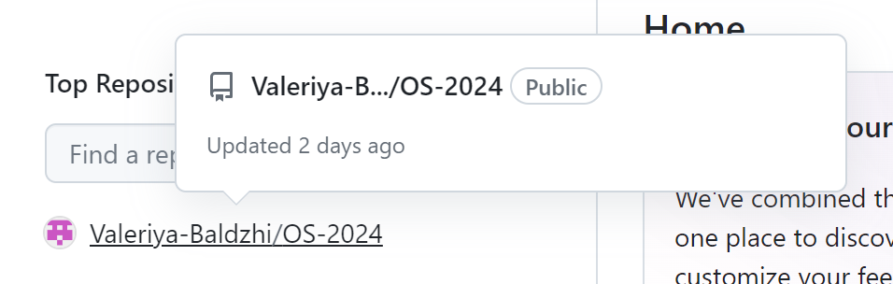
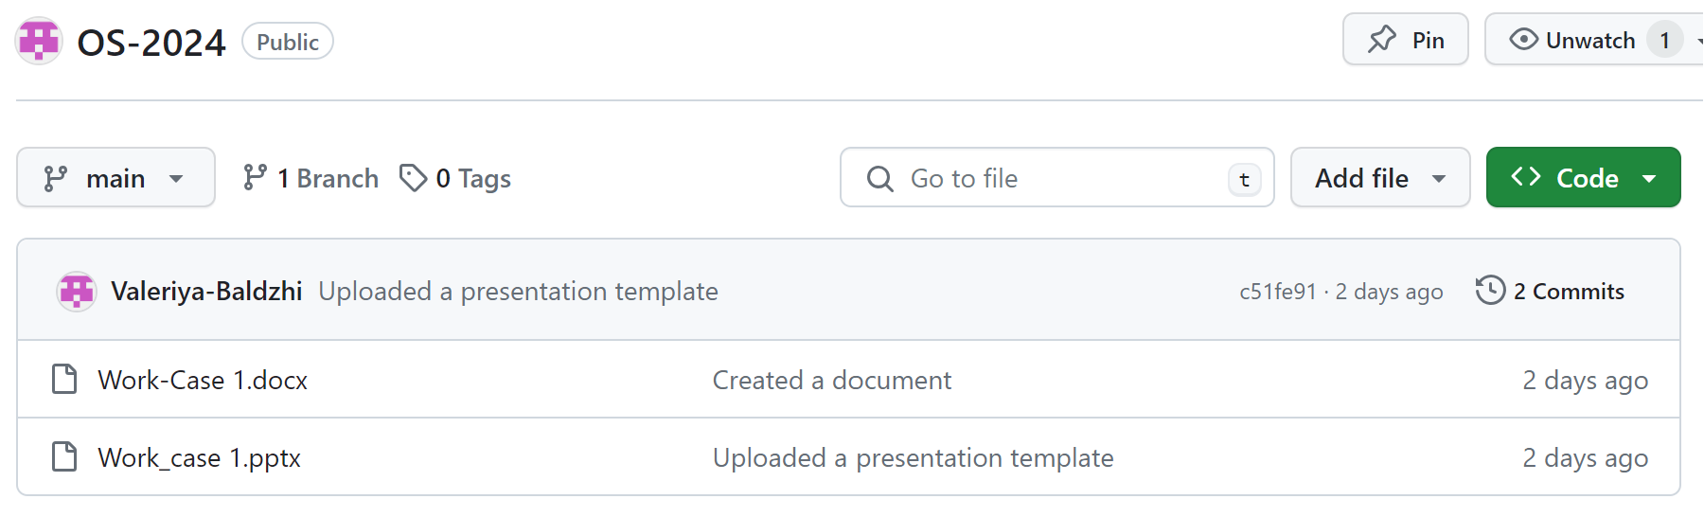

Slide 11

Human Resource Management

Slide 12
Standardizing
No More Paper
Better Admin
The software helps in standardizing HR management
Uniform standards help get rid of paper records
Uniform standards help get rid of paper records

Slide 13
Record Keeping
Data-Base
Maintenance of proper records
Database management preserves and organizes all human resource data

Slide 14

Keep a Proper Database
Database management techniques aid in cross-referencing.
Patient research and documents well organized in consulting

Slide 15

Financial Management and Record Advantages

Slide 16
Financial Management and Record Advantages
Links with Inventory Management
Timely procurement
Stocktaking
Prudent financial management via IT solutions
Processing of bills
Salaries of hospital employees
Month-to-month analysis

Slide 17

Conclusion
IT solutions are the future of hospital management and dialogue between policymakers and
hospital administrators.

Slide 18

Thank You
For Your Time!

